Slide 1
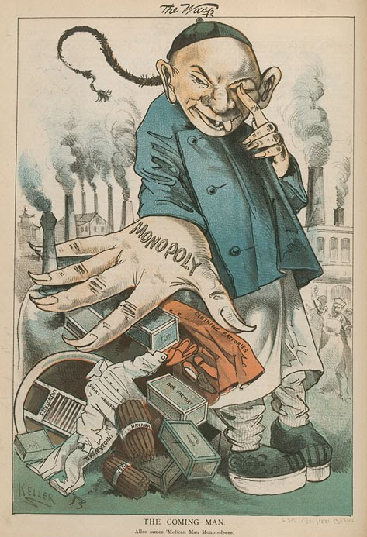
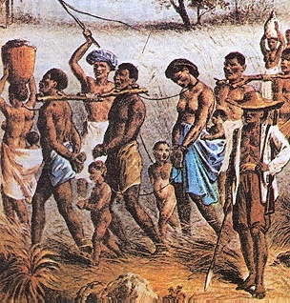
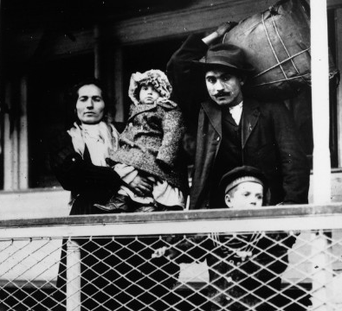

The History of Immigration and Citizenship in the United States: Open Border Era
Artemus Ward
Dept. of Political Science
Northern Illinois University
aeward@niu.edu
Bill of Rights Institute

Slide 2
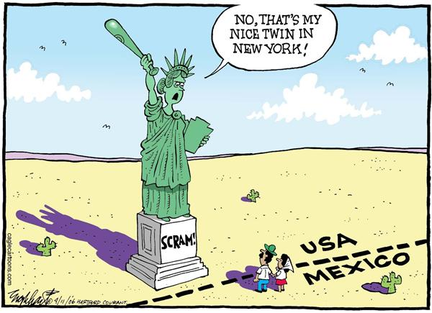
Introduction
The United States has often been described as a nation of immigrants. People from around the globe have been drawn here, creating a diverse, dynamic culture and a wealthy, powerful nation. At the same time, debates about the rights of newcomers have persisted since our nation's founding.
Early American immigration history was characterized by essentially open borders with the initial colonial era and subsequent “old wave” period where immigrants from northwestern Europe arrived to create and grow the new nation.
They were followed by a “new wave” of southern and eastern Europeans as well as Asians, particularly the Chinese. The resulting backlash ushered in a restrictive era at the end of the 19th Century.
The pattern is plain: every major immigrant group that came to America faced a nativist backlash that resulted in discrimination and violence at the hands of native-born Americans who descended from immigrants.
This is the central paradox that has plagued immigration history: despite the fact that all Americans (other than the indigenous native peoples—American Indians) are descended from immigrants and however invaluable to the nation’s economy and material comfort they may be, Americans exploit, marginalize, and particularly now, regard immigrants with suspicion, distrust, and hatred.

Slide 3
American Immigration Eras
I. OPEN BORDERS
Colonial Era (1600-1776)
Old Wave Era (1840-1879)
II. CLOSED BORDERS
New Wave Era (1882-1924)
Restrictive Era (1924-1965)
III. Liberalizing Era (1965-2016?)
While historians have generally classified the “new wave” era of southern and eastern European immigrants as part of the initial period of essentially open borders, more recent scholarship argues that the major shift in American immigration policy happened in 1882 with the exclusion of Chinese immigrants and subsequent restrictive actions prior to 1924.

Slide 4
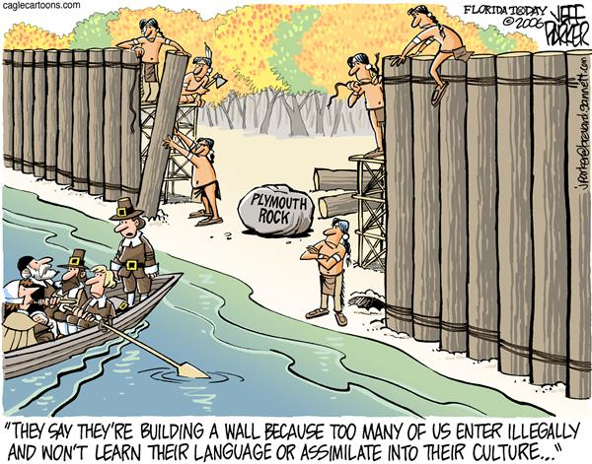
First Immigrants: British Colonists
British colonists were the first American immigrants.
They arrived on the East Coast in the 16th and 17th Centuries.
They came for economic opportunity and religious freedom.

Slide 5
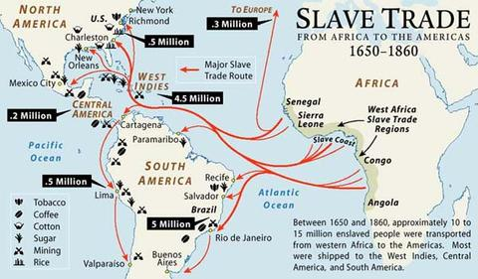

African Slaves
African slaves were forcibly brought to colonial America in the 17th and 18th Centuries.
At the founding, 1 out of every 5 people in the U.S. was of African descent.
In total, half a million African slaves had been sent to North America and the U.S. before 1808.

Slide 6
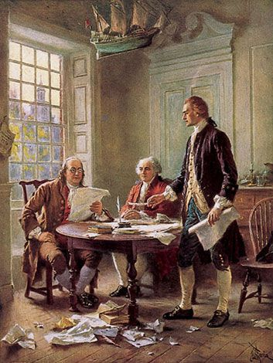
Declaration of Independence (1776)
The founding generation knew that continued immigration was vital to help fill their largely empty new nation.
The Declaration of Independence’s list of complaints against King George III included the charge that the king had "endeavored to prevent the population of these States ... obstructing the laws for the naturalization of foreigners [and] refusing to pass others to encourage their migration hither."

Slide 7
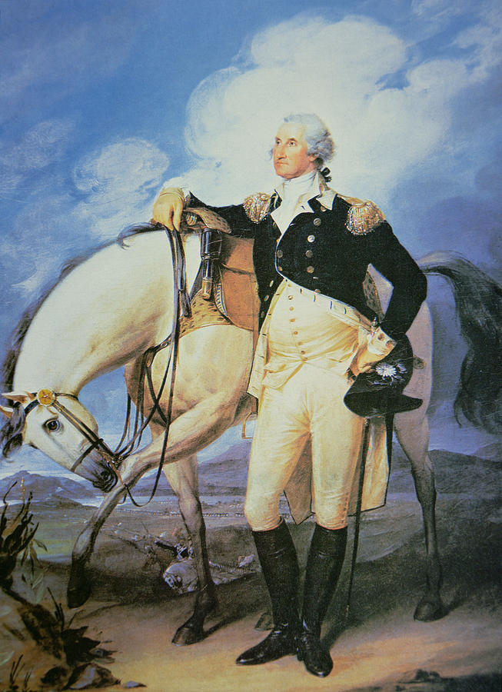
George Washington’s Address to Irish Immigrants (1783)
Washington, addressing an association of Irish immigrants just after the battle of Yorktown, said:
“The bosom of America is open to receive not only the opulent and respectable stranger, but the oppressed and persecuted of all nations and religions, whom we shall welcome to participate in all of our rights and privileges, if by decency and propriety of conduct they appear to merit the enjoyment.”
Later, President Washington wrote John Adams in 1794: “My opinion with respect to emigration, is, that except of useful Mechanics and some particular descriptions of men or professions, there is no need of encouragement: while the policy or advantage of its taking place in a body (I mean the settling of them in a body) may be much questioned; for, by so doing, they retain the Language, habits and principles (good or bad) which they bring with them. Whereas by an intermixture with our people, they, or their descendants, get assimilated to our customs, measures and laws: in a word, soon become one people.”

Slide 8
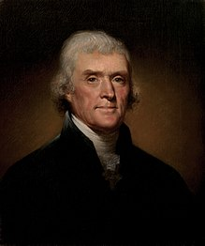
Thomas Jefferson on Immigration (1785)
“[Immigrants] will bring with them the principles of the governments they leave, imbibed in their early youth; or, if able to throw them off, it will be in exchange for an unbounded licentiousness, passing, as is usual, from one extreme to another. It would be a miracle were they to stop precisely at the point of temperate liberty. These principles, with their language, they will transmit to their children. In proportion to their numbers, they will share with us the legislation. They will infuse into it their spirit, warp and bias its direction, and render it a heterogeneous, incoherent, distracted mass….
If [immigrants] come of themselves, they are entitled to all the rights of citizenship: but I doubt the expediency of inviting them by extraordinary encouragements. I mean not that these doubts should be extended to the importation of useful artificers [skilled craftsmen or inventors]. The policy of that measure depends on very different considerations. Spare no expense in obtaining them.”

Slide 9
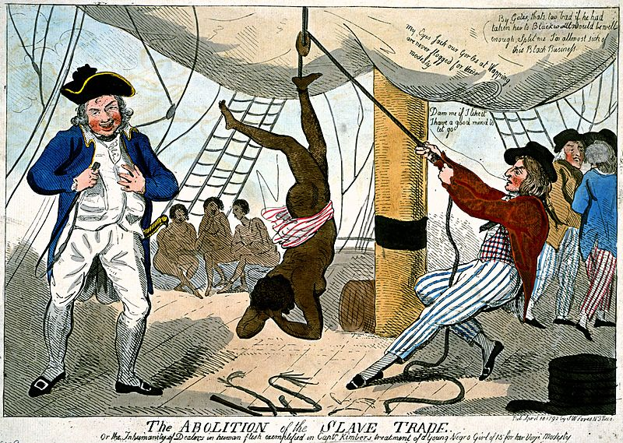
U.S. Constitution (1787)
Eleven years after the Declaration, the authors of the Constitution clearly had immigration in mind when they provided that Congress should "establish a uniform rule of naturalization" (Article I, Section 8) and made immigrants eligible for all federal offices save president and vice president.
They also protected the foreign slave trade, a major source of immigration, by prohibiting interference with it for twenty years (Article 1, Section 9).
When that period expired, Congress, at President Jefferson's invitation, promptly made that trade illegal, but did not interfere with either the domestic slave trade or slavery itself.
The approximately 50,000 slaves smuggled into the U.S. after 1808 became the first illegal immigrants.

Slide 10
Naturalization Act (1790)
Article 1, Section 8 of the U.S. Constitution empowers the Congress to “Establish a Uniform Rule of Naturalization.”
Based on this authority, Congress acted immediately to pass the first statute in the U.S. to codify naturalization law.
Alternately known as the Nationality Act, the Naturalization Act of 1790 restricted citizenship to “any alien, being a free white person” of “good character” who had been in the U.S. for two years.
It excluded American Indians, indentured servants, slaves, free blacks and later Asians although free blacks were allowed citizenship at the state level in certain states.
It also provided for citizenship for certain children of U.S. citizens born abroad:
“the children of citizens of the United States that may be born beyond Sea, or out of the limits of the United States, shall be considered as natural born Citizens: provided, That the right of citizenship shall not descend to persons whose fathers have never been resident in the United States.”
In 1795, the residence requirement was extended to 5 years.
In 1798, the residence requirement was extended to 14 years.
In 1802, the residency requirement was reduced to 5 years.
In 1855 citizenship was automatically granted to alien wives of U.S. citizens.
In 1870 the naturalization process was opened “to persons of African descent.”

Slide 11
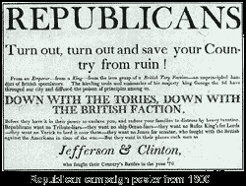
Alien and Sedition Acts (1798)
The anti-immigrant legislation of the John Adams administration in the late 1790s was not so much an effort to restrict immigration as a desperate but vain attempt to keep Federalism in power and Jeffersonians out.
Federalists generally opposed only those immigrants who they thought might vote for Jefferson.
Apart from that episode, a pro-immigrant consensus long prevailed, a consensus well described in President John Tyler's 1841 message to Congress: "We hold out to the people of other countries an invitation to come and settle among us as members of our rapidly growing family."

Slide 12
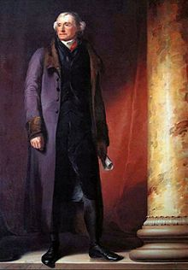
President Thomas Jefferson’s First Annual Address to Congress (1801)
“And shall we refuse the unhappy fugitives from distress that hospitality which the savages of the wilderness extended to our fathers arriving in this land? Shall oppressed humanity find no asylum on the globe? The constitution, indeed, has wisely provided that, for admission to certain offices of important trust, a residence shall be required sufficient to develop character and design.
But might not the general character and capabilities of a citizen be safely communicated to every one manifesting a bona fide purpose of embarking his life and fortunes permanently with us? With restrictions, perhaps, to guard against the fraudulent usurpation of our flag…”

Slide 13
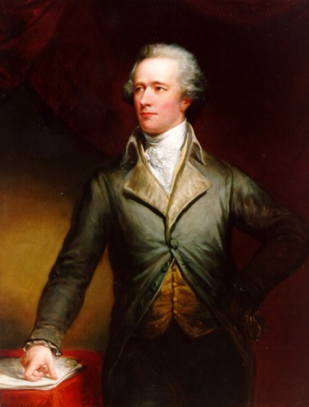
Alexander Hamilton’s response to Jefferson’s Address (1802)
“The influx of foreigners must, therefore, tend to produce a heterogeneous compound; to change and corrupt the national spirit; to complicate and confound public opinion; to introduce foreign propensities. In the composition of society, the harmony of the ingredients is all-important, and whatever tends to a discordant intermixture must have an injurious tendency….
Some reasonable term [of naturalization] ought to be allowed to enable aliens to get rid of foreign and acquire American attachments; to learn the principles and imbibe the spirit of our government; and to admit of a probability at least, of their feeling a real interest in our affairs. A residence of not less than five years ought to be required [in order to obtain citizenship].”

Slide 14
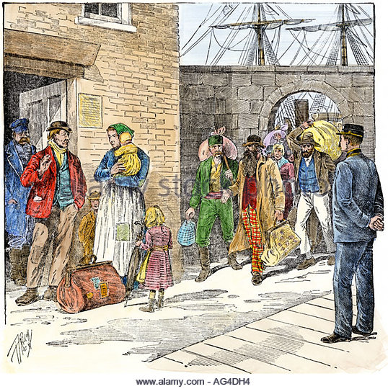
Antebellum Immigration
Prior to the Civil War, the federal government did little to supervise immigration and it was generally left to the states.
Coastal states with large ports, such as Massachusetts, New York, Pennsylvania, and Maryland, established mechanisms to monitor and process the accelerating influx of immigrants.
New York, for example, passed laws requiring ships’ masters to report the name, occupation, birthplace, age, and condition of passengers and to pay a small head-tax on each of them.
Coastal states established immigration boards, staffed by amateur volunteers, to execute these new laws. State lawmakers hoped that these measures would reduce the admission of potential indigents, diseased and insane people, and other custodial cases.
The first federal statute dealing directly with free immigration was not enacted until 1819, when Congress ordered, as part of a statute dealing with import duties, that every vessel entering an American port deliver a manifest of passengers being landed to the collector of customs for that district.
No other federal immigration statutes were enacted until after the Civil War.

Slide 15
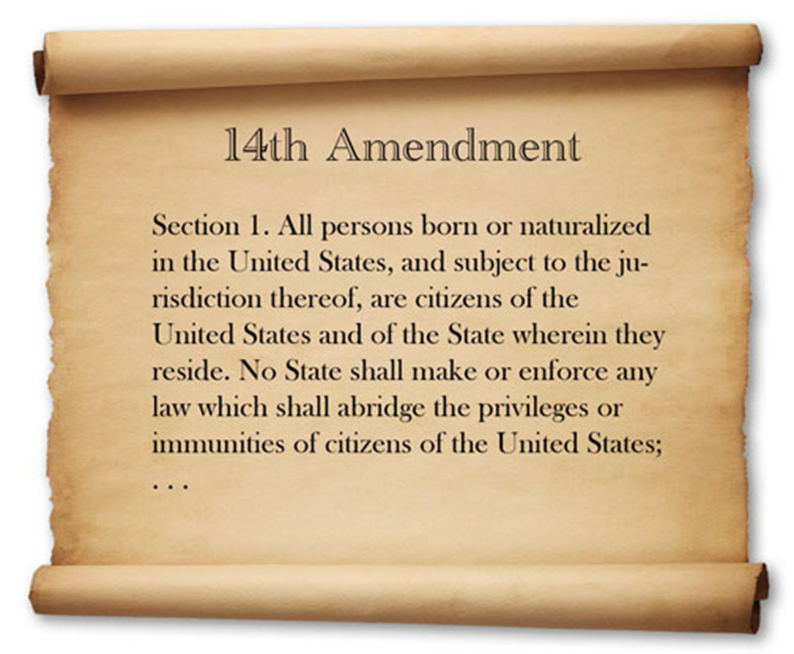
Post-Civil War Amendments (1865-1868)
In 1865 the 13th Amendment was ratified, outlawing slavery.
In 1866 congress pass the Civil Rights Act specifying that former slaves were citizens of the U.S.
In 1868 the 14th Amendment was ratified, and made plain what the Civil Rights Acts had promised: “All persons born or naturalized in the United States and subject to the jurisdiction thereof, are citizens of the United States and of the State wherein they reside.”
The amendment granted citizenship to people born within the U.S. and subject to its jurisdiction, but it excluded untaxed Indians (those living on reservations). It also prohibited the states from abridging the privileges of federal citizenship.
The construction of the citizenship clause indicates that anyone born in the U.S. is automatically a citizen, and this is what federal law has maintained ever since.
However, there is disagreement as to the meaning of the citizenship clause, and whether it was intended to clarify the status of emancipated slaves, or whether it was written to apply to all peoples regardless of context.

Slide 16
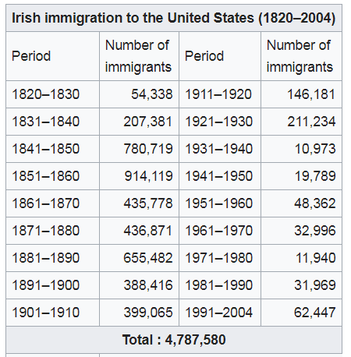
Irish
Many colonial settlers coming from the province of Ulster (mostly present-day Northern Ireland) came to be known in the U.S. as the “Scots-Irish.” Most of them were descendants of Scottish and English tenant farmers who had been settled in Ireland by the British government during the 17th-century Plantation of Ulster. An estimated 250,000 migrated to the United States during the colonial era.
Irish immigration had greatly increased beginning in the 1820s due to the need for labor in canal building, lumbering, and civil construction works in the Northeast. The large Erie Canal project was one such example where Irishmen were many of the laborers. Small but tight communities developed in growing cities such as Philadelphia, Boston, New York and Providence.
From 1820 to 1860, 1,956,557 Irish arrived, 75% of these after the Great Irish Famine “potato famine” of 1845–1852, struck.

Slide 17
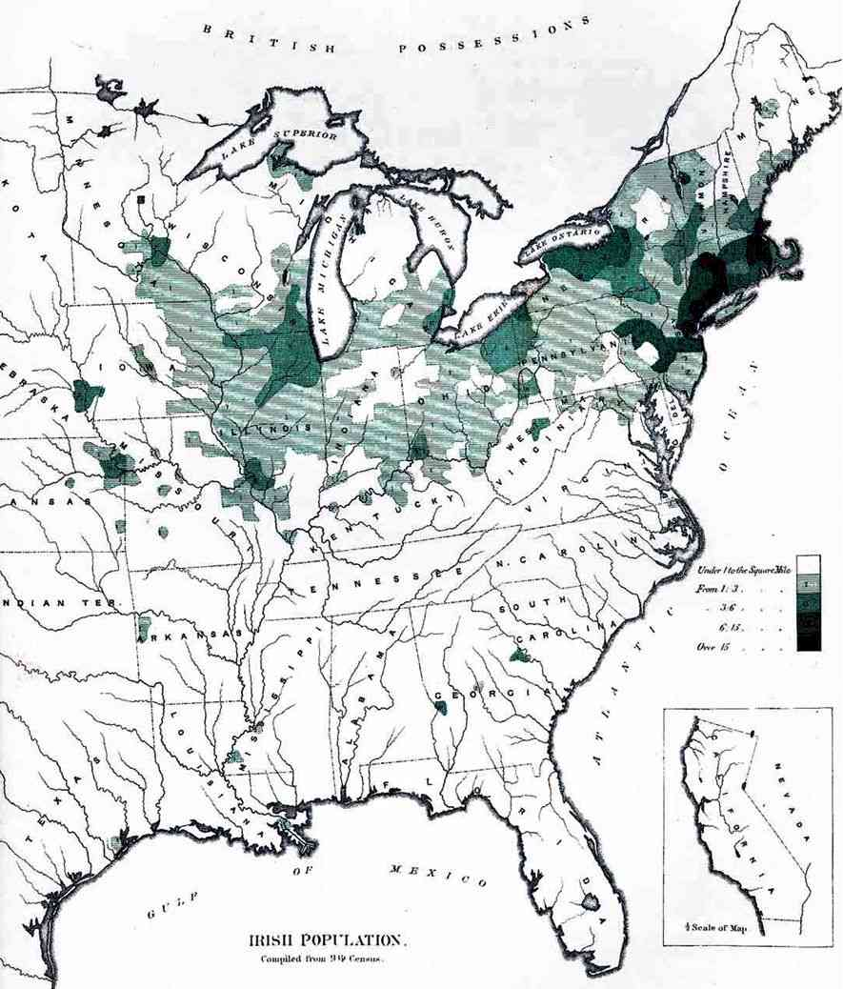
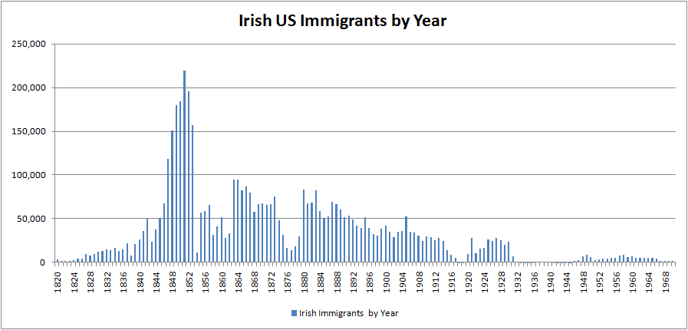
Irish
Irish immigrants went largely to the northeastern United States, many entering through Boston and New York, with a substantial minority entering via Canada. Almost all Irish settled in cities as far south as Baltimore and as far west as Cincinnati.
Large numbers of them moved into new urban occupations such as policemen, firemen, and horse-car drivers, as well as unskilled labor.
The map shows the Irish population in 1872 (darker green equals more Irish).

Slide 18
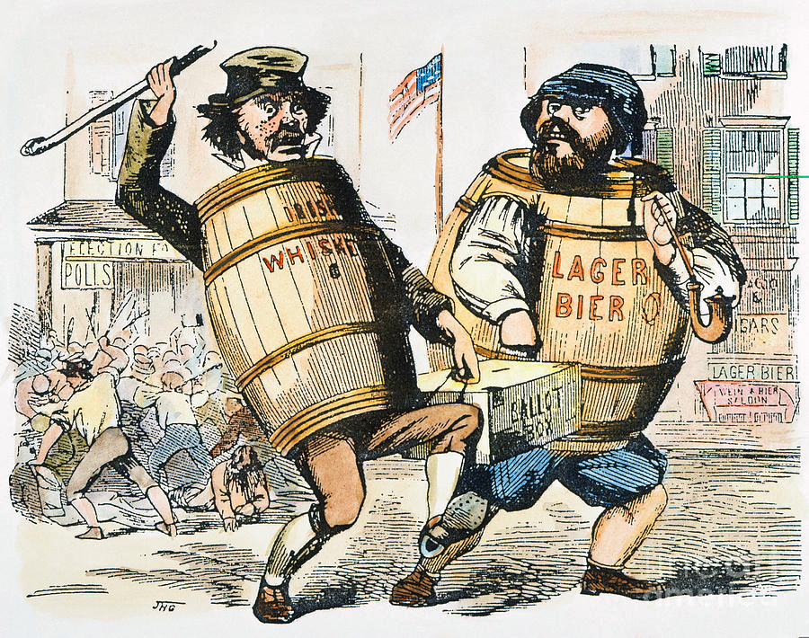
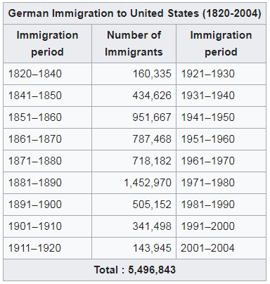
Germans
The largest flow of German immigration to America occurred between 1820 and World War I, during which time nearly six million Germans arrived.
From 1840 to 1880, they were the largest group of immigrants.
They were the first significant immigrant group who did not speak English.

Slide 19
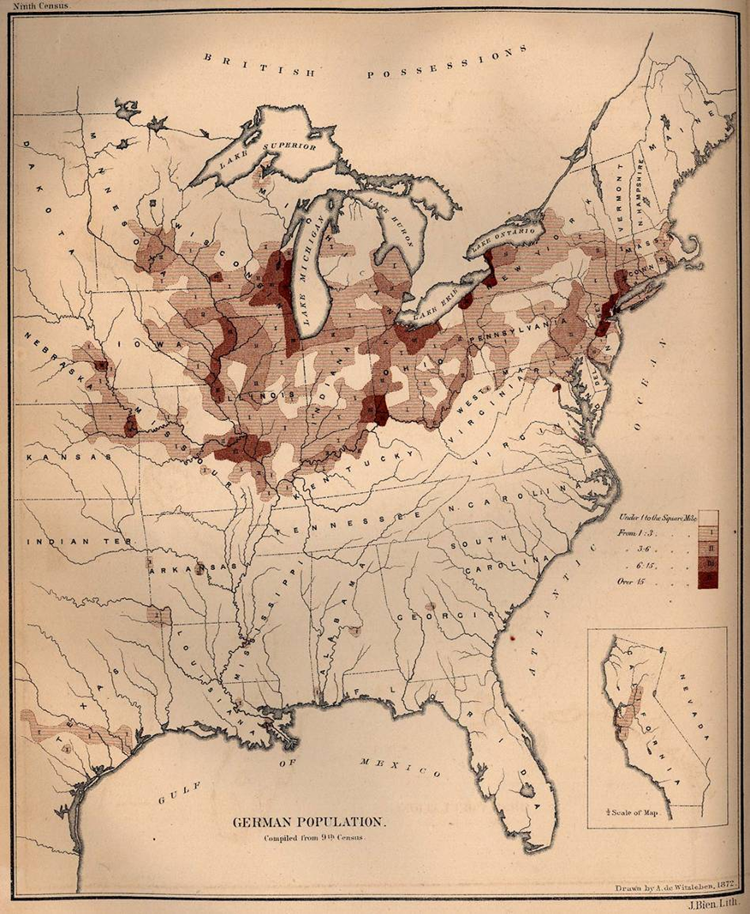
Germans
Unlike the Irish, almost no Germans settled in New England; most entered through New York, which supplanted Philadelphia as the chief immigrant port in the 1820s.
German settlement in the East was concentrated between New York and Baltimore, but a growing minority settled within the area between St. Louis, Cincinnati, and Milwaukee, which scholars have called the "German Triangle."
Many Germans came seeking farms and found them, while large numbers were skilled craftsmen.
The map shows the German population in America in 1872.

Slide 20
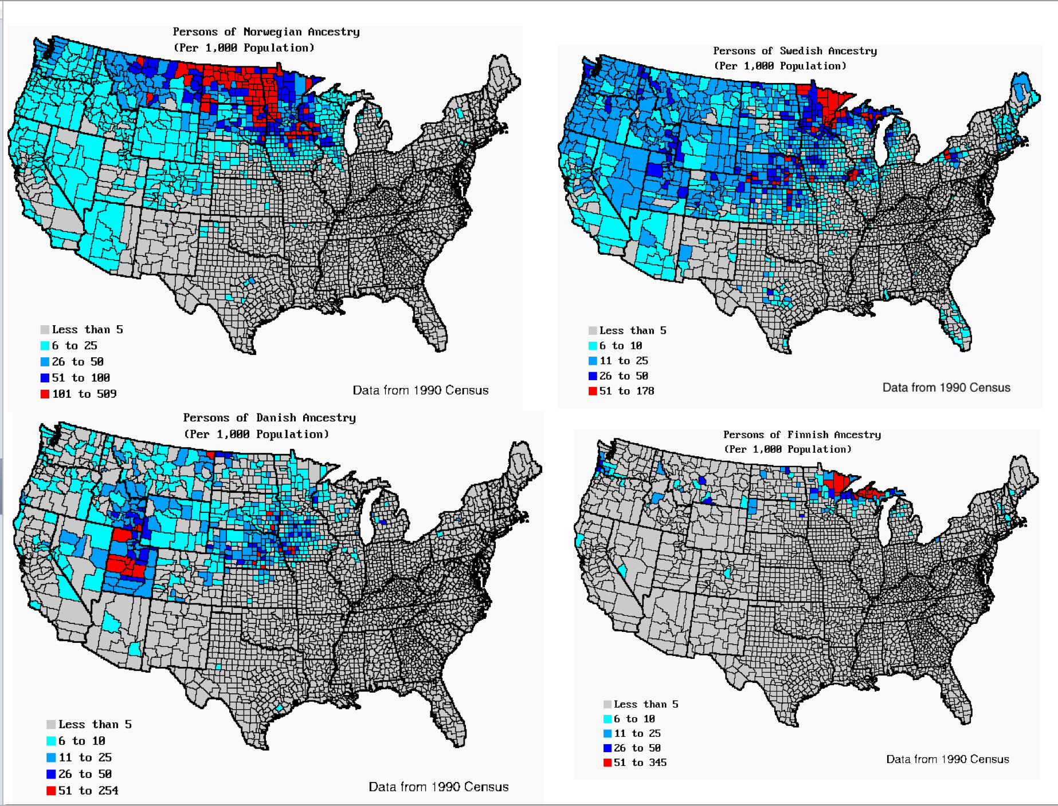
Scandinavians
Scandinavians from Sweden, Norway, Denmark, and Finland arrived in America at the end of the 19th Century.
Though not as numerous as German or Irish immigrants, Scandinavians still arrived in massive numbers. 1,000,000 Swedes (1868–1914), 800,000 Norwegians (1825–1925), 300,000 Danes (1820–1920), and 230,000 Finns (1890–1924) forever transformed the culture of the American Midwest.
Like the immigrants that came before them, Scandinavians left due to economic reasons (overpopulation, famine, lack of jobs) and came to America because of the social mobility, religious freedom, and available farmland.

Slide 21
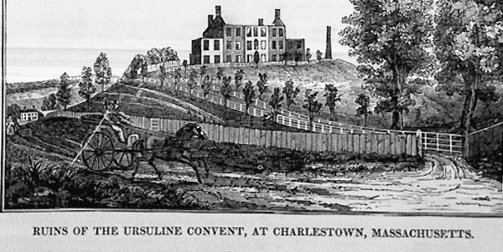
Nativist Backlash
The frustration of Protestant nativist groups over the increasing immigration and the growing crisis over slavery were the preconditions for the first anti-immigrant mass movement in American history.
In the 1830s and 1840s violent anti-Catholic riots occurred, primarily in New England and Philadelphia: in 1834, just outside Boston, a mob burned down an Ursuline convent; and in Philadelphia during the 1840s a number of mobs attacked Catholic churches.
No organization accepted responsibility, as we say today, but by the early 1850s a new political movement had been born, directed largely against immigrants.

Slide 22
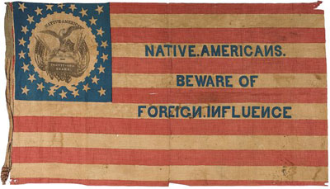
Nativist Backlash
The Know-Nothings, as contemporary opponents and later historians called them, were members of a secret Protestant fraternal organization, the Order of the Star-Spangled Banner, whose members had to be native-born white Protestants who took an oath to "[resist] the insidious policy of the Church of Rome, and all other foreign influences against the institutions of our country, by placing in all offices in the gift of the people, whether by election or by appointment, none but native-born Protestant citizens." Members of the Order were instructed to reply "I know nothing" to any questions about the organization.
It had a meteoric rise, growing from just 43 members to more than a million in a little over two years. A million white males represented almost one-eighth of the nation's potential electorate (in 1852 just some 6 million men voted for president). It is therefore no surprise that anti-immigrant candidates did well in the elections of 1854 and 1855, electing eight governors, more than a hundred congressmen, the mayors of Boston, Philadelphia, and Chicago, and thousands of other local officials.
Many states enacted anti-immigrant statutes in this period. In Massachusetts, for example, naturalized citizens were denied the vote until two years after they became citizens, an act that particularly outraged Abraham Lincoln. The movement's national agenda included lengthening the period required for naturalization from 5 to 14, various proposals to limit immigration, and a constitutional amendment barring foreign-born citizens from holding any public office.

Slide 23
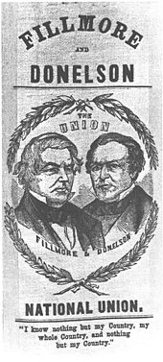
Know Nothings
Emboldened by its electoral success, the Order formed the American Party in 1840 and in 1856 ran ex-President Millard Fillmore for president on a platform that ignored the slavery issue but included anti-immigrant planks.
Fillmore got more than 800,000 votes, 21.5% of the electorate, but carried only the state of Maryland and finished behind Democrat James Buchanan (45.3%) and Californian John C. Fremont, the nominee of a new party (Republicans) who won 33.1%.
The American Party collapsed and, by 1860, so had the Know-Nothing movement.
The Civil War years, in which immigrant soldiers fought for both the Union and the Confederacy, often in ethnic regiments or smaller units, ended, for a time, the anti-immigrant furor.
The Know-Nothings did not achieve any of their agenda, but they serve as an exemplar of one kind of anti-immigrant movement: one whose major objection to immigrants is their religion.

Slide 24
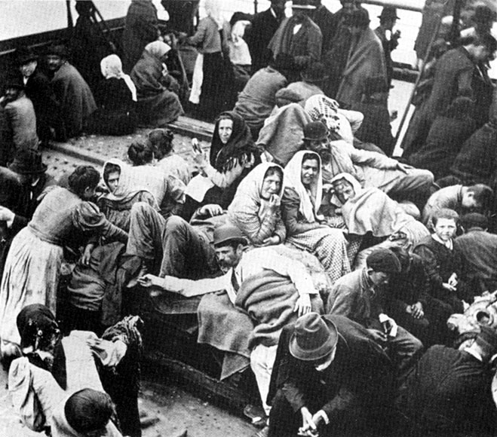
“New Wave” Immigration Era (1880-1924)
Starting in the 1880s, a “new wave” of immigration took place.
Unlike their light-skinned predecessors who immigrated from northwest Europe, the darker-skinned new wave came from Southern and Eastern Europe. This difference in origin, language, and ethnicity—including the color of their skin—meant they stood out more than the previous generation of immigrants.
They arrived as America shifted from an agrarian to an industrial nation.
Southern Italians settled in the East Coast and worked in factories.
Eastern Europeans (predominately from Austria- Hungary, Poland, and Russia) left for different reasons. Many of these immigrants were Jewish and driven out due to increasing religious persecution. Most came through Ellis Island (which opened in 1892) and settled in the lower east side of Manhattan.

Slide 25
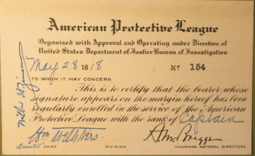
Shift from Religion to Race & Ethnicity
The depression-scarred 1890s saw a minor reprise of organized anti-Catholicism.
The short-lived American Protective Association, founded in Iowa in 1887 by a still-obscure man named Henry Bowers, had its greatest appeal in the rural Midwest and the Pacific Northwest.
Its political agenda was similar to that of the Know-Nothings, but it had little national impact and faded with the return of relative prosperity around 1900.
Yet, religious prejudices against Catholics and Jews continued to be an important element of many subsequent anti-immigrant movements, though never again at their core.
In the post-Civil War years that core was provided first by race and then by ethnicity as the issue of Chinese immigration became nationally prominent. This, along with the turmoil of Reconstruction, helped to focus anti-immigrant sentiments on race rather than religion.

Slide 26
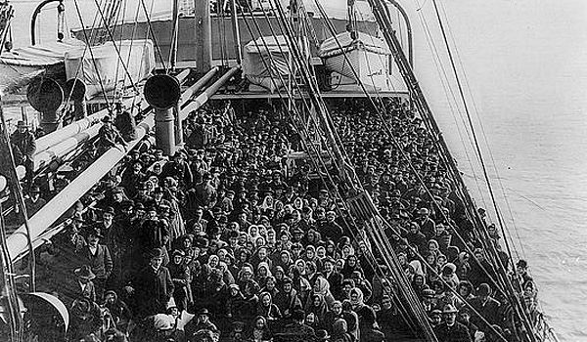
Further Reading
Daniels, Roger. 2005. Guarding the Golden Door: American Immigration Policy and Immigrants since 1882. Hill & Wang.
Daniels, Roger. 2002. Coming to America: A History of Immigration and Ethnicity in American Life, 2nd ed. Harper.
Gerber, David. 2011. American Immigration: A Very Short Introduction. Oxford.

